Slide 1
Lord of the sticks
By:
Brain Alexander, John Bailey, Austin Dewitt, Trey Page

Slide 2

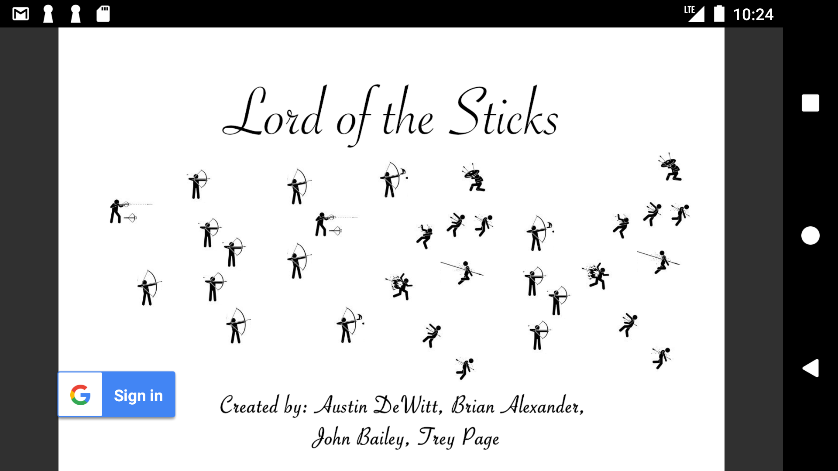
What is l.o.t.s.?
Notes:
L.O.T.S. is Lord of the Sticks. An online multi-player battle royale game.
It is powered by the game engine LibGDX,
supported by an online database via Firebase,
securely connected with Google sign in/firebase authentication,
and players are brought together with Google Play Games services.

Slide 3
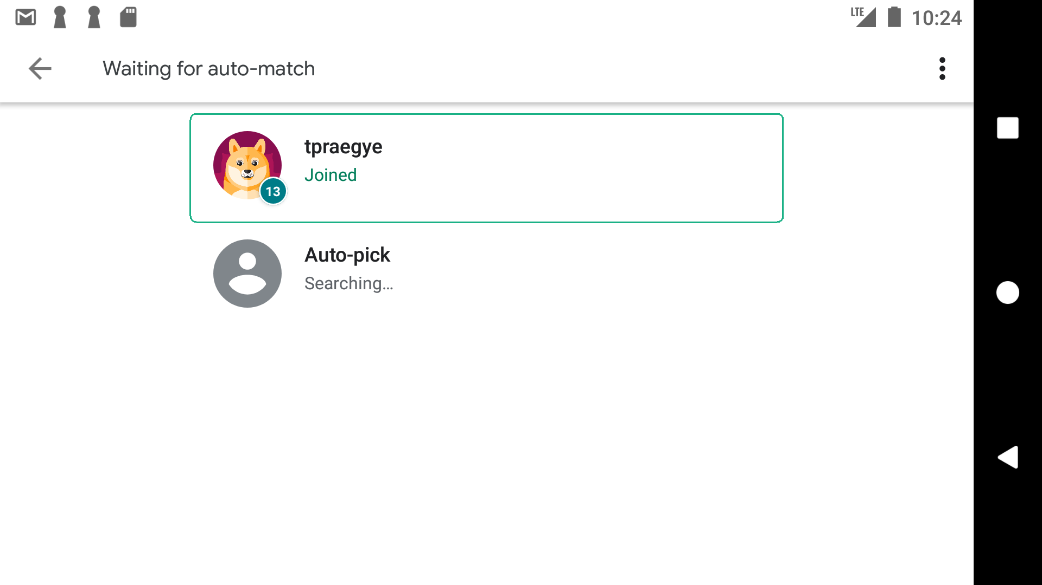
Google play game services
Implementation
Confusion
Get players together
Notes:
The team decided to use google play game services for the purpose of getting multiple users into the same room.
Our team consistently assigned tasks to complete then met up 24 hours later to discuss. If someone felt stuck we would switch tasks around.
This switch happened multiple times during the project. The game engine was swapped to every team member, firebase was swapped back and forth twice, and this was no different.
This task was worked on by close to 48 hours and then swapped, after the swap the 2 team mates were able to bounce ideas off of each other and had it implemented within the day. One big victory in the project was when the game launched a waiting room, connected 2 people, and launched our game.
This task required a lot of work to be done online with all of the different google based consoles to allow the users the right access.

Slide 4
Google/ firebase authentication
Authentication?
Do I have to?
Security
Notes:
I’m sure everyone has seen a google sign in button somewhere. That is google authentication. When that button is clicked your google account is connected to the game and the game will request for some of your information.
This is where the team decided to take no information besides email and not store anything.
The team was worried when we first started that the email and password sign in could potentially be a security risk to our users. Switching to google sign in allowed us to release our responsibility of holding the users information.
However, we did need that account to connect to firebase, so we do use the email.
This email allows the user access to the game and read information from the database and join a game via google play games services.

Slide 5

Firebase - the cloud database
Easy to implement
Easy to understand
Easy to learn
So we thought….
Notes:
Our application is using firebase to hold onto information and allow our game to read and write quickly and easily.
Of all the things that we had to do in this game, firebase was probably the most straight forward. We ran into very few problems…

Slide 6
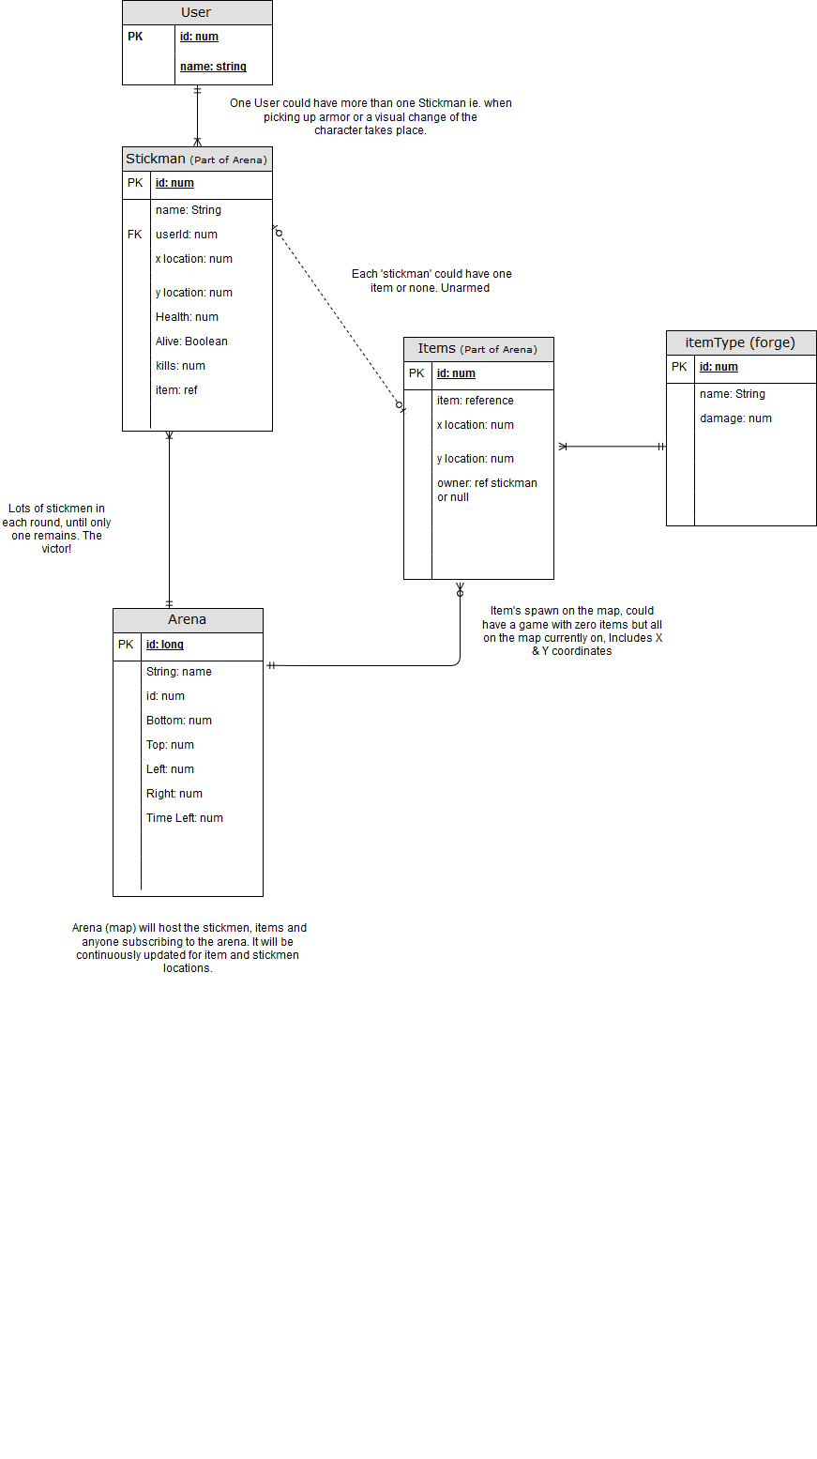
Typical database
Structure

Slide 7
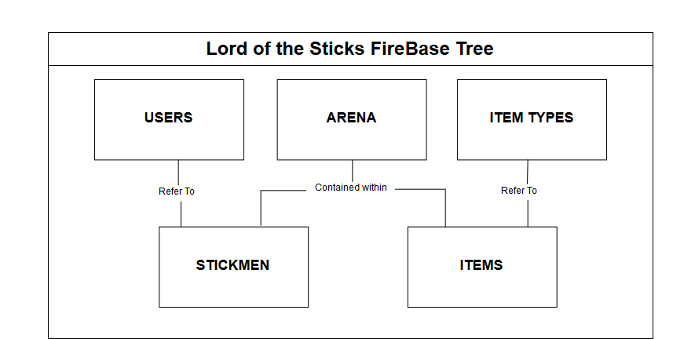

Slide 8

Early mistakes
Security risks
Team-work
Notes:
When we originally started with our application we decided to use email and password to log in and authenticate through firebase. This was exciting and worked well.
However, once we started using google play games services we had to have a google account connected.
Once we switched that over, we had to figure out how to connect the google account with firebase.
The team got this all figured out quickly and efficiently through team-work and a quick team decision.
Next we’ll talk about how we fixed our concerns

Slide 9

libGDX, the game engine
The Engine itself.
Why libGDX?
Notes:
A game engine is a toolbox that allows us to borrow their tools instead of making our own. The tools in this case are things like physics, collision-detection, animation, and the general map.
We chose libGDX instead of other game engines because of trial and error.
After attempting to implement 3 different game engines we ran into fatal errors that made us drop them and start over.
However, even after libGDX was working and ready to be implemented…..

Slide 10
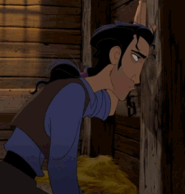
Disaster struck
The home stretch?
Notes:
The team had 2 projects, our game engine, and our application. It took the team 2 pizzas, a couple beers, and 7 straight hours to make the square peg go in the round hole.
At this point we were on the home stretch, the app was running, connecting people, and the engine was functioning properly. There is still more work to be done but we are proud of the work we have done and the amount we have learned.

Slide 11
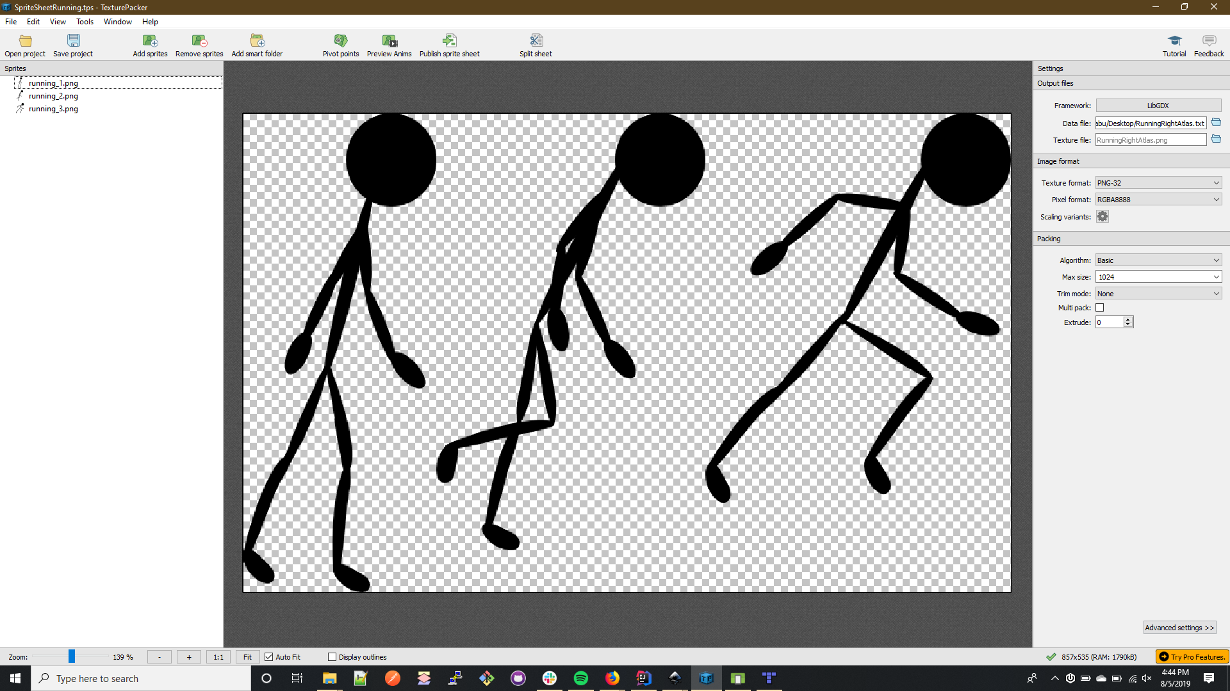
Notes:
Used a Texture Packer to make a sprite sheet, which would loop through the image horizontally spacing out the individual frames into equal parts so that when the image is shown it looks like it’s running or jumping etc. Libgdx gives us a tool to give our stickman physics such as gravity and velocity and a collision box around him.

Slide 12
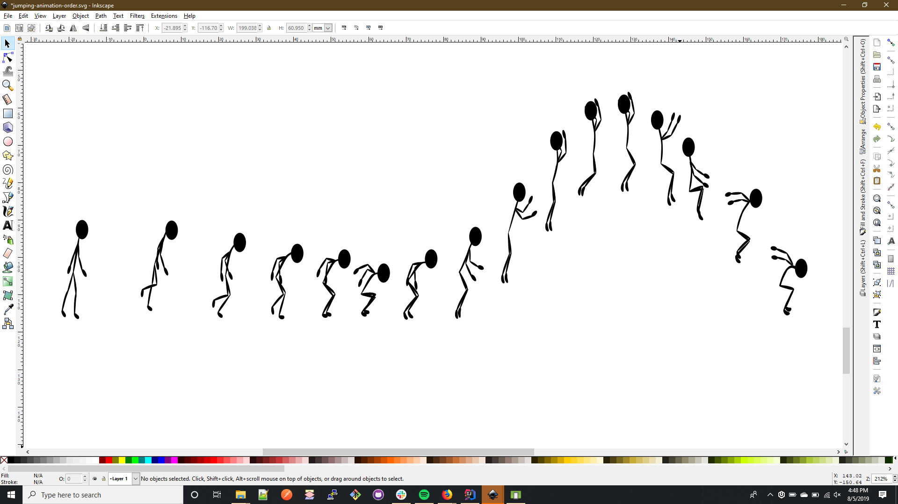

Slide 13
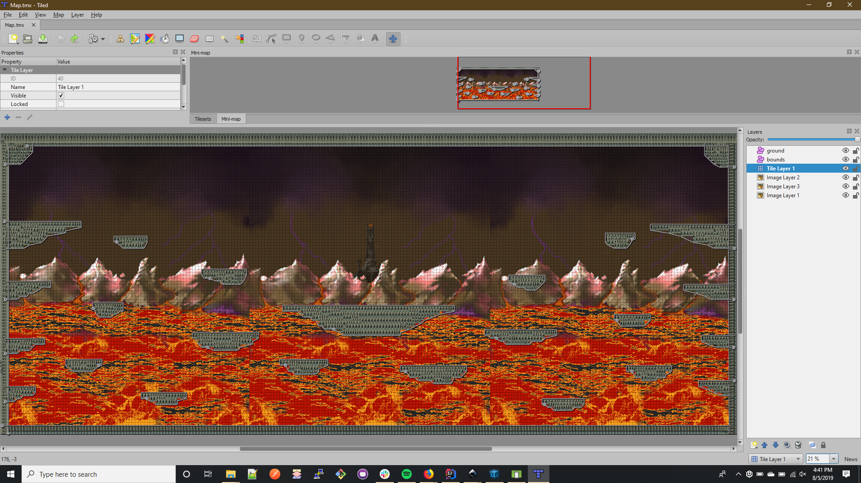
Notes:
Used Tiled to make a map. It was a major pain resolved by shrinking the map. It used layers for borders and ground collision using poly lines not polygons! Our code could not read polygons. Took us several hours to figure that out. We could also use those lines to damage a player with say a spike pit or lava etc
Libgdx was big undertaking that we should have used from the very beginning instead of spending hours writing our own code for the physics and controls. In the end all it took was some pizza, beer, camaraderie, and 7 hours... but we finally forced it to work with our code... perseverance was definitely key and maybe some beer too

Slide 14


Slide 15
Questions?

